Slide 1

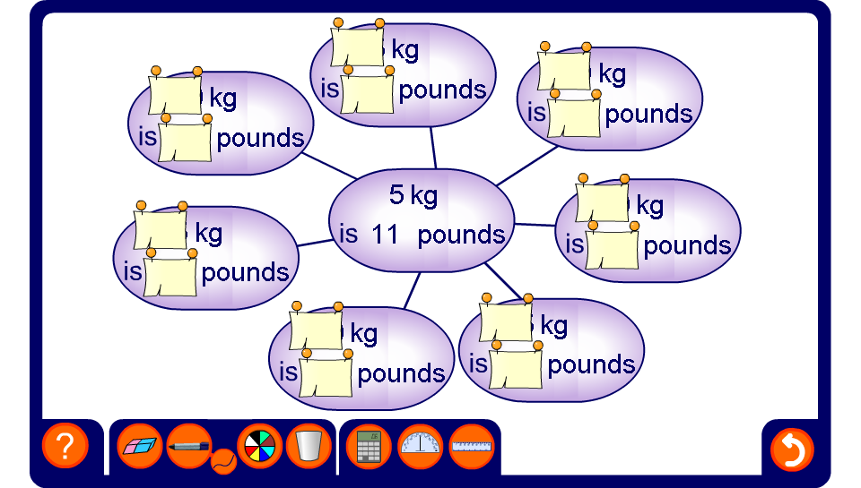


Spider diagram
Notes:
Use proportional reasoning to complete the spider diagram.

